Slide 1
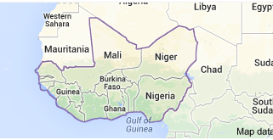
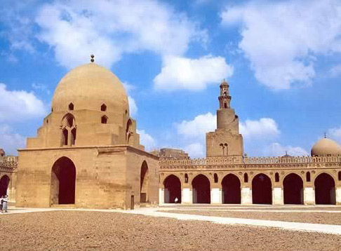
Islam in West Africa
How Islamic was West African society?

Slide 2
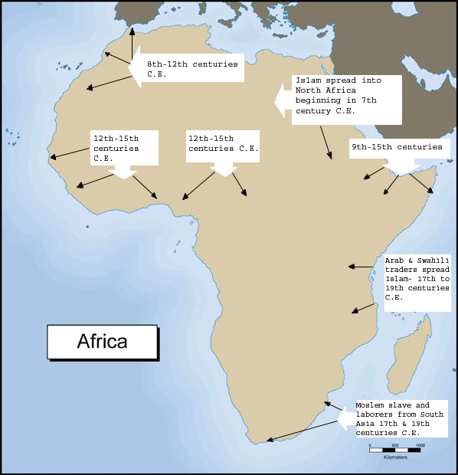
The Arrival of Islam

Slide 3
Introduction of Islam

Slide 4
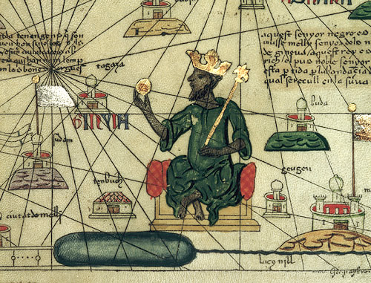
Conversion to Islam
Mansa Musa

Slide 5
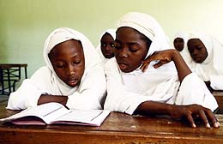
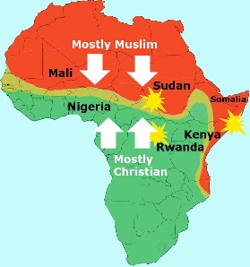
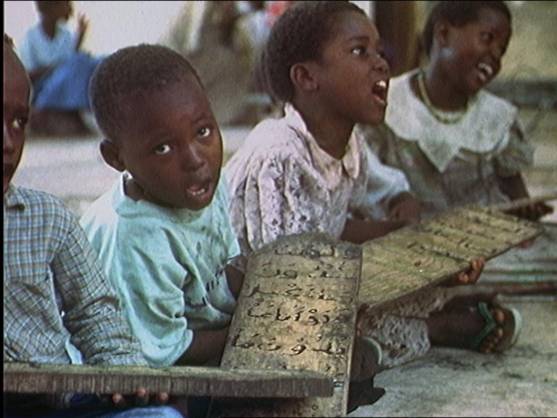
African Islam

Slide 6
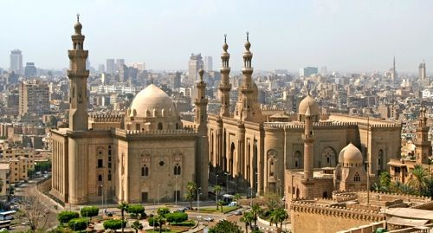
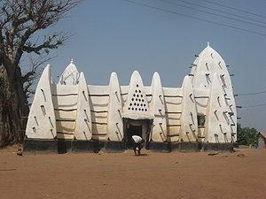
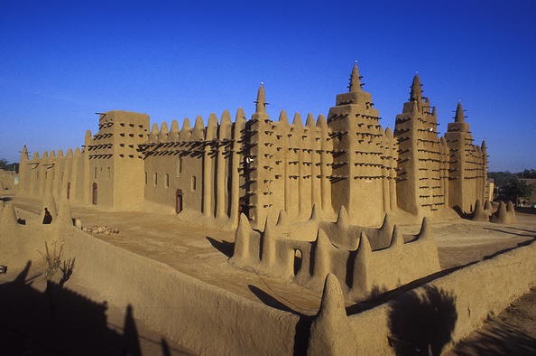
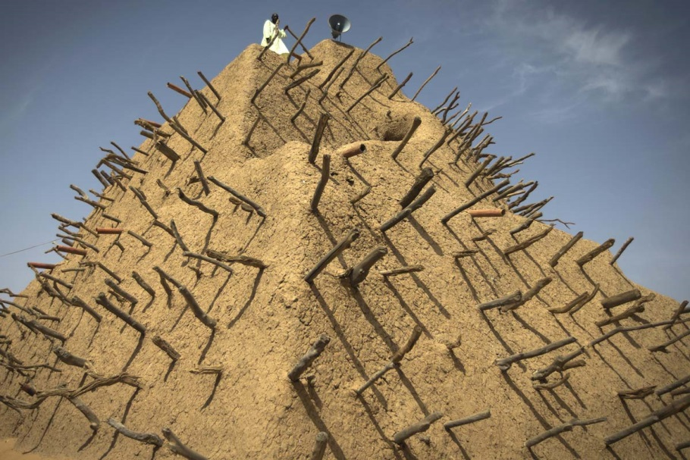
Mosques
Jenne, Mali
Larabanga, Ghana
Gao, Mali

Slide 7
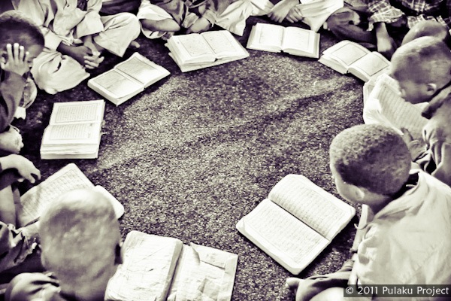
Madrasas

Slide 8
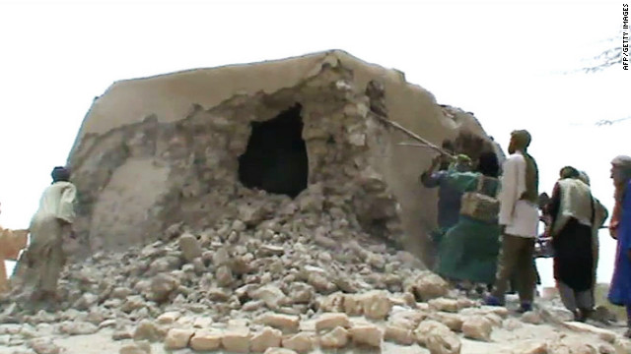
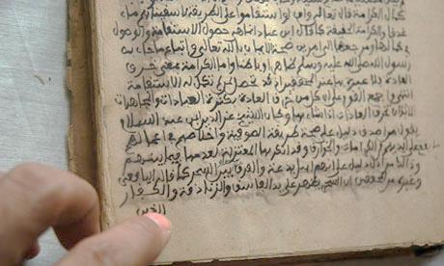
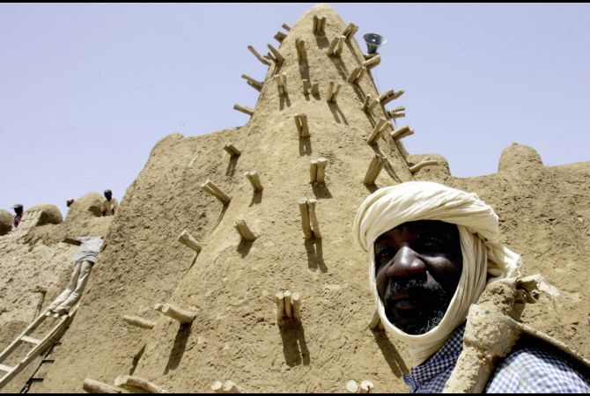
Timbuktu

Slide 9
PAUSE.

Slide 10
Ibn Battuta’s Description
Another of their good qualities is their zeal for learning the Koran by heart. They put their children in chains if they show any backwardness in memorizing it, and they are not set free until they have it by heart. I visited the Qadi in his house on the day of the festival. His children were chained up, so I said to him, "Will you not let them loose?" He replied, "I shall not do so until they learn the Koran by heart.“
Among their bad qualities are the following. The women servants, slave-girls, and young girls go about in front of everyone naked, without a stitch of clothing on them. Women go into the sultan's presence naked and without coverings, and his daughters also go about naked. Then there is their custom of putting dust and ashes on their heads, as a mark of respect.

Slide 11
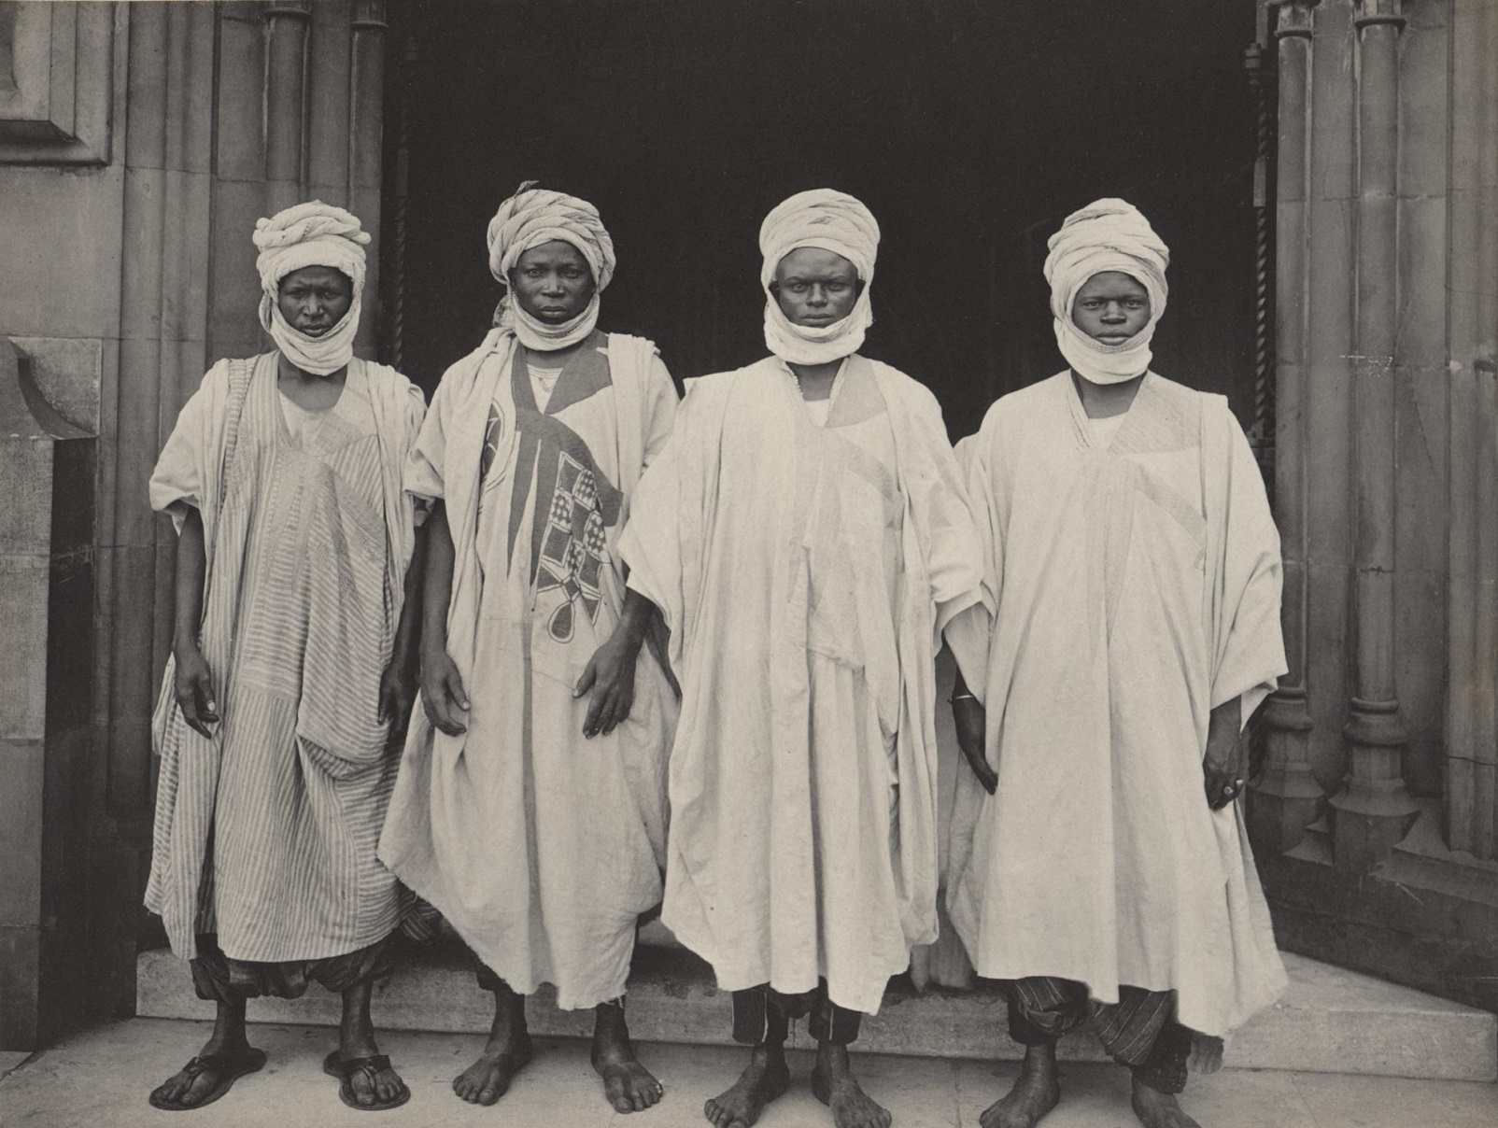
Enduring African Traditions

Slide 12
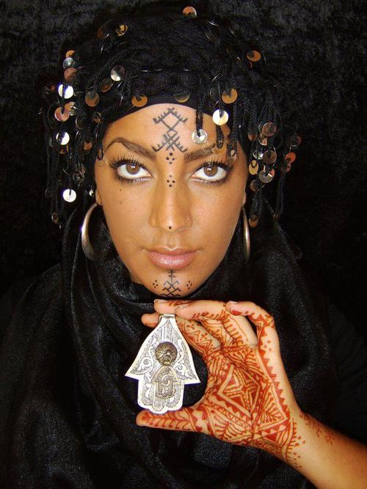
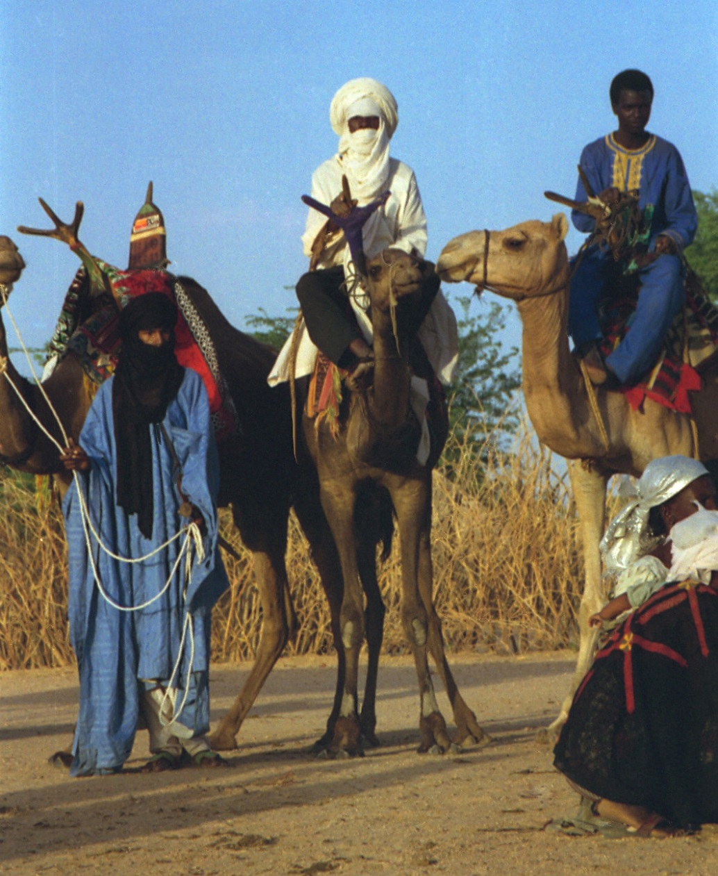
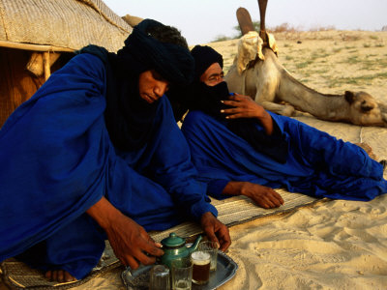
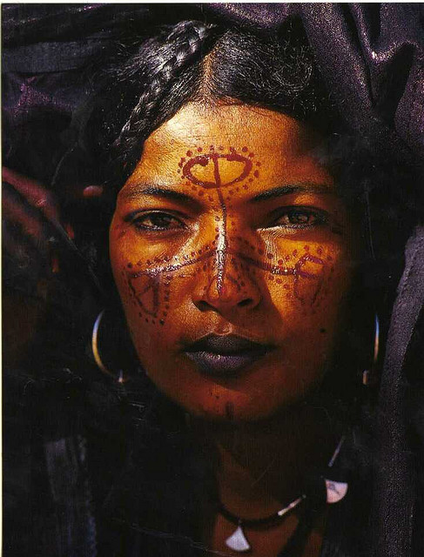
Tuareg People
Mali, Niger, Chad, Algeria

Slide 13
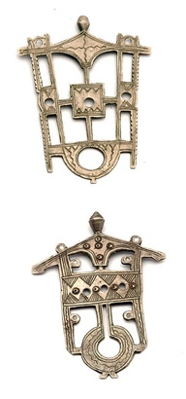
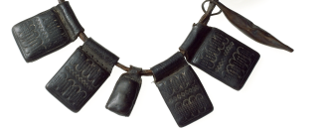
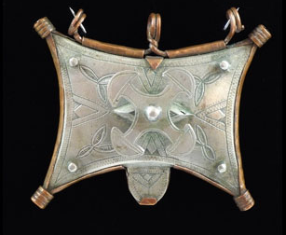
Amulets

Slide 14
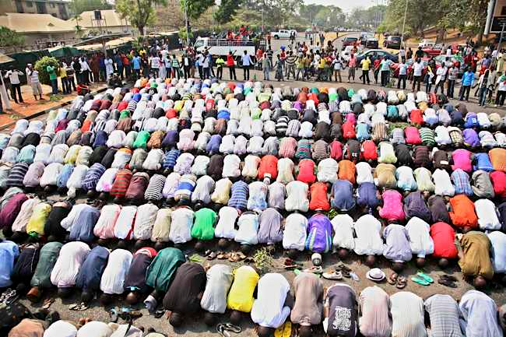
Conclusion

